Slide 1
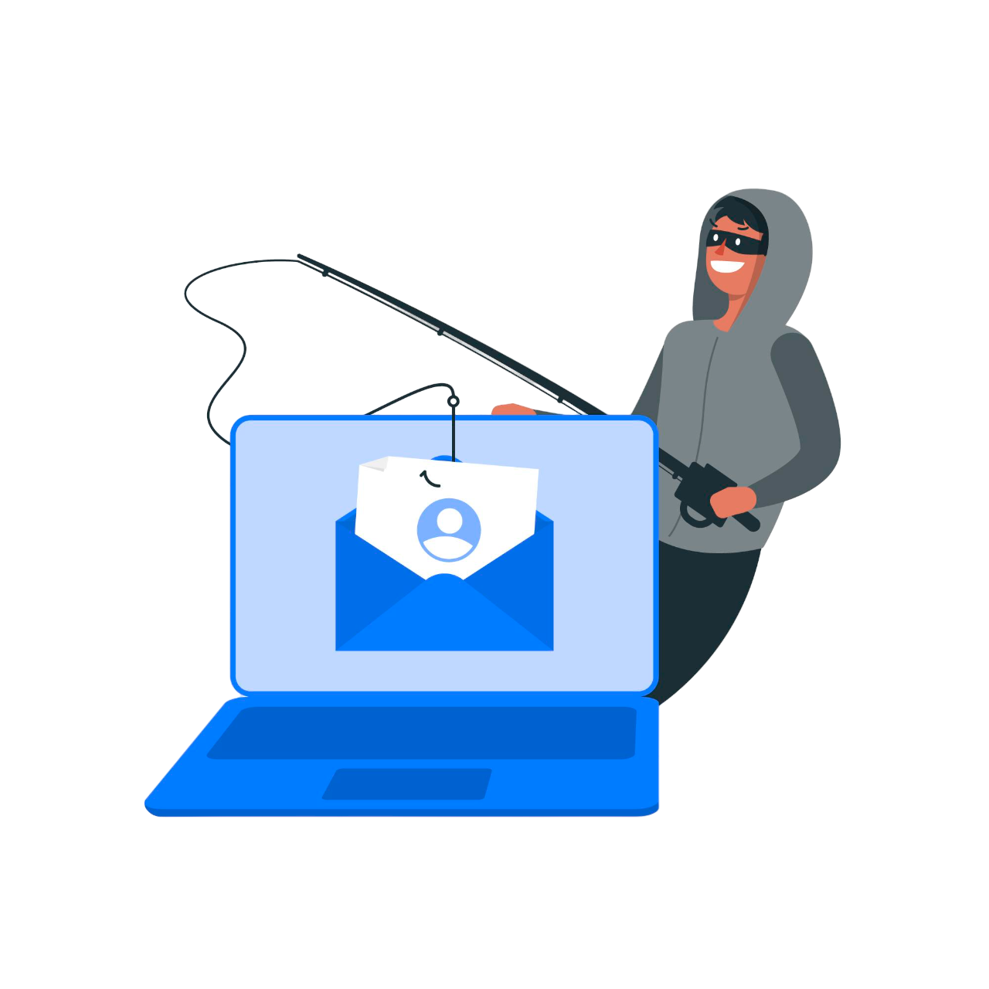
Go-Phish
An email-based phishing detection tool
By Tahmid Miah, 20022779

Slide 2
Project Background
Everyday 3.4 billion emails are spam.
During Placement year saw a lot of Phishing emails
Wanted to explore what tools were already out there for smaller businesses.

Slide 3
Previous Solutions
General solutions
Solutions in SMEs
Mainly Theoretical solutions i.e. ML Models, or eye tracking data.
Heavy emphasis on security awareness training
Phishing Simulation Exercises

Slide 4
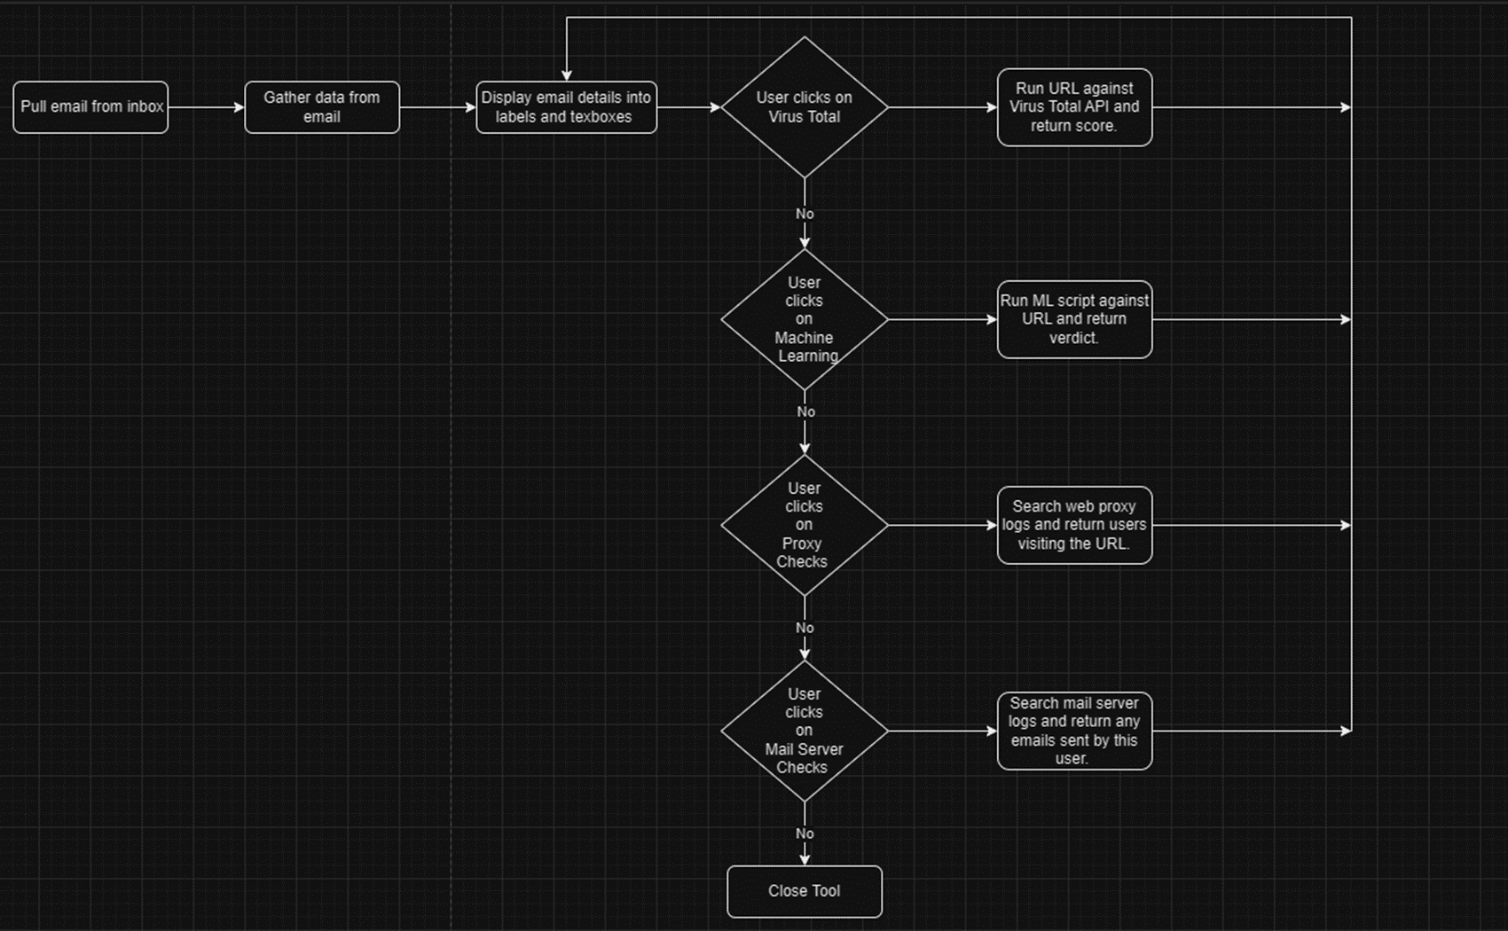
Go-Phish Solution
“The aim of the tool was to create an intuitive desktop application targeted for those with minimal or no technical knowledge, but also satisfy the needs of technical users who may wish to use the tool, in order to help them detect phishing emails. The tool uses new and existing technologies combined into one practical solution.”

Slide 5
Techniques to solve problem
Machine Learning
OSINT
Visualization
Log Searching
URL Redirect Discovery

Slide 6
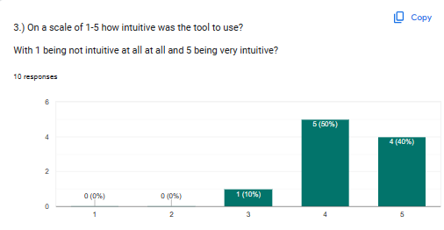
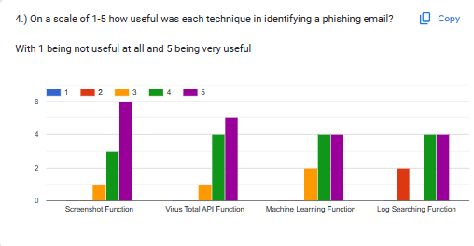
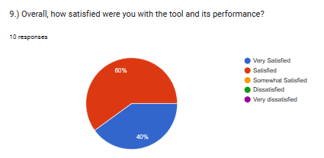
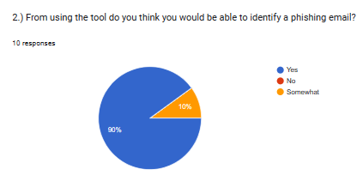
Solution Effectiveness
96.6% Machine Learning Accuracy
90% of users said they think they would be able to identify a phishing email using the tool.
High user satisfaction:
60% of users very satisfied and 40% left satisfied with the tool.
90% of users rated the tool a 4 or 5 (with 5 being very intuitive.)

Slide 7
Challenges Faced
Technical:
The IMAPLib library was not stable
Using Tkinter made it difficult to create GUI
Dealing with email data not being in plain text.
Virus Total API not being able to scan URLs that have not been seen before.
Non-Technical:
Time management, juggling 3 units at a time.
Lack of knowledge and experience.

Slide 8
Future Improvements
Login Page to different mailbox servers.
Research different API’s
Improve Machine Learning Dataset
Connecting to Logs

Slide 9

Showcase

Slide 10
Any Questions ?
Thank you for listening ☺

